Slide 1

Welcome to Year 5

Slide 2

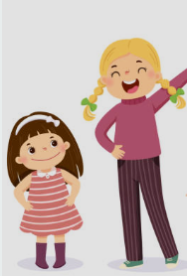

Teaching Staff
5DP- Miss Patterson (Team Leader)
5LH- Mrs Hancock
5AB- Miss Bedding
TAs-
Mrs Pruszewicz
Mrs Arthur
Mrs Fostekew
Please feel free to see any of us if you have any concerns or questions. You can catch us after school or you can email the office. We will get back to you as soon as we are free.

Slide 3


First day- we shall collect children from the playground.
After- children to enter via the double doors at the top of the slope.
Please collect from the playground. We shall exit from the doors at the top of the slope.
Doors will open at 8.30am.
School will finish at 3.20pm.

Slide 4

School Values

Slide 5
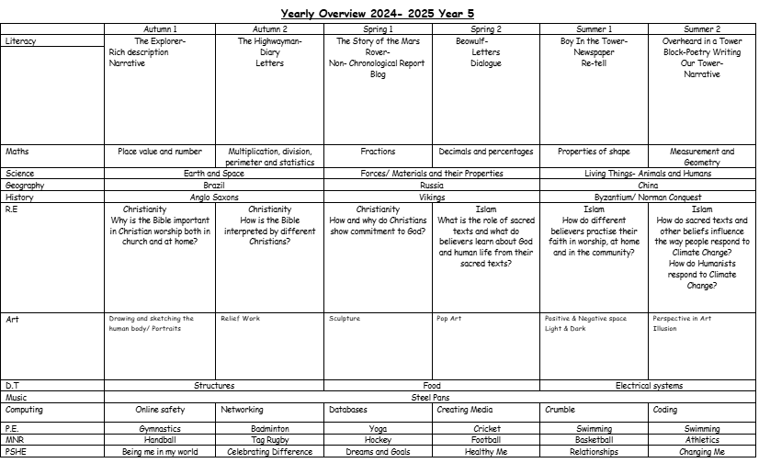
Changing Me- RSE. A timetable and more information of each lesson will be sent out with Summer 1 and 2 Curriculum Letter. As these are now statutory, if you wish to remove your child from any of these lessons you must meet with Mrs Rostron before Summer Term 2.

Slide 6

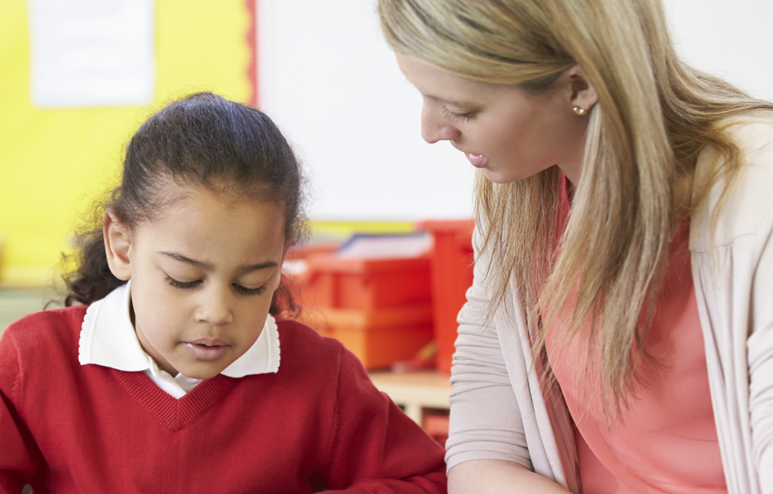
Expectations
Please support the Year 5 Team:
Please ensure your child is punctual to school and ready to learn.
Please listen to your child read every day and complete their Reading Record- they will bring home 1-2 books a week and at least one library book.
Please support your child with the completion of homework.
Homework will be set on a Friday and due in the following Wednesday- this will be online or a paper copy, if necessary
Please ensure your child has their correct PE kit on their PE days- TBC.

Slide 7


Slide 8


Slide 9
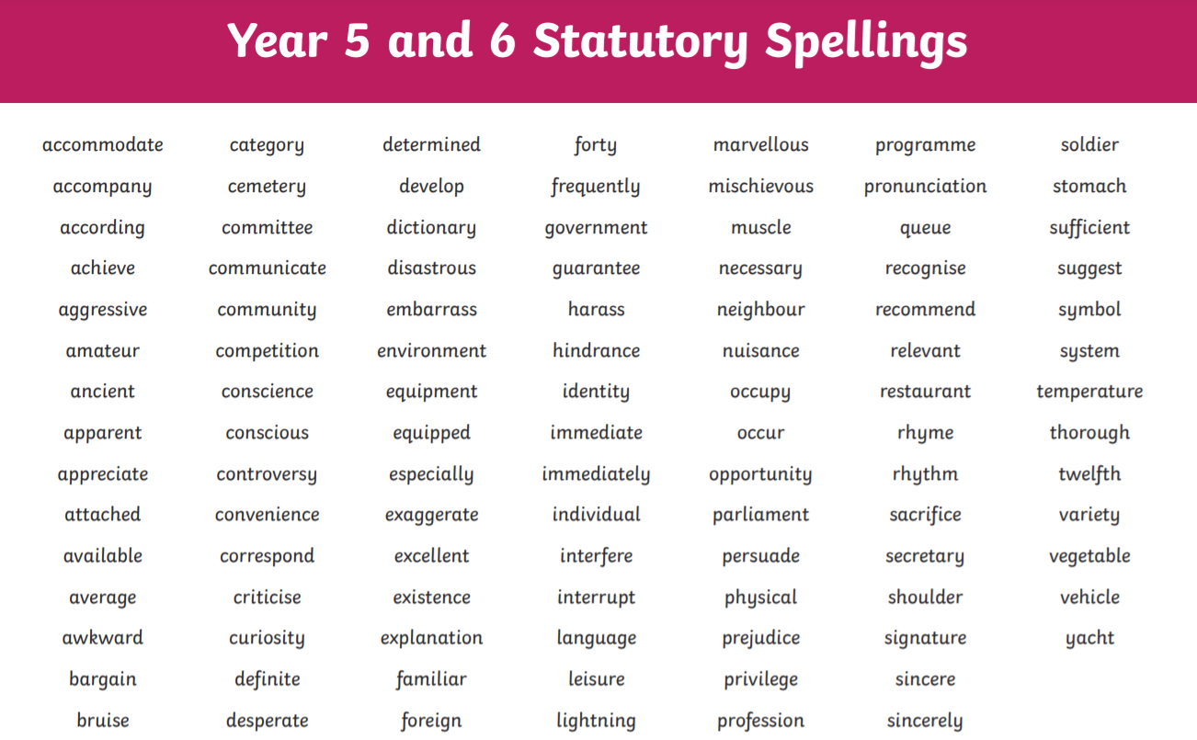

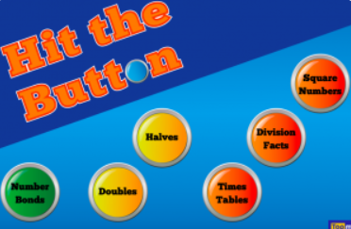
Expectations
Please ensure your child continues to practice multiplication and related division facts, up to 12 x 12
Children can continue to practice using TTRS and Hit the Button
Please support your child to learn their personalised spelling words- they will get a copy to bring home at the beginning of the year.

Slide 10
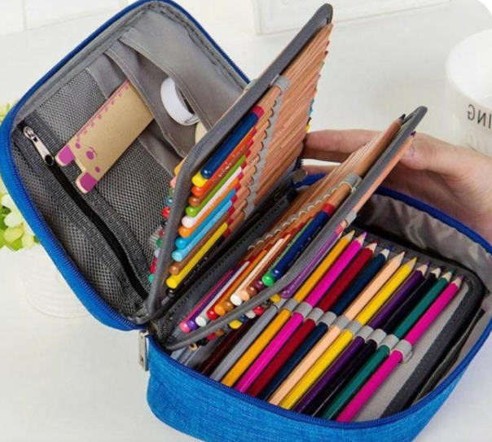
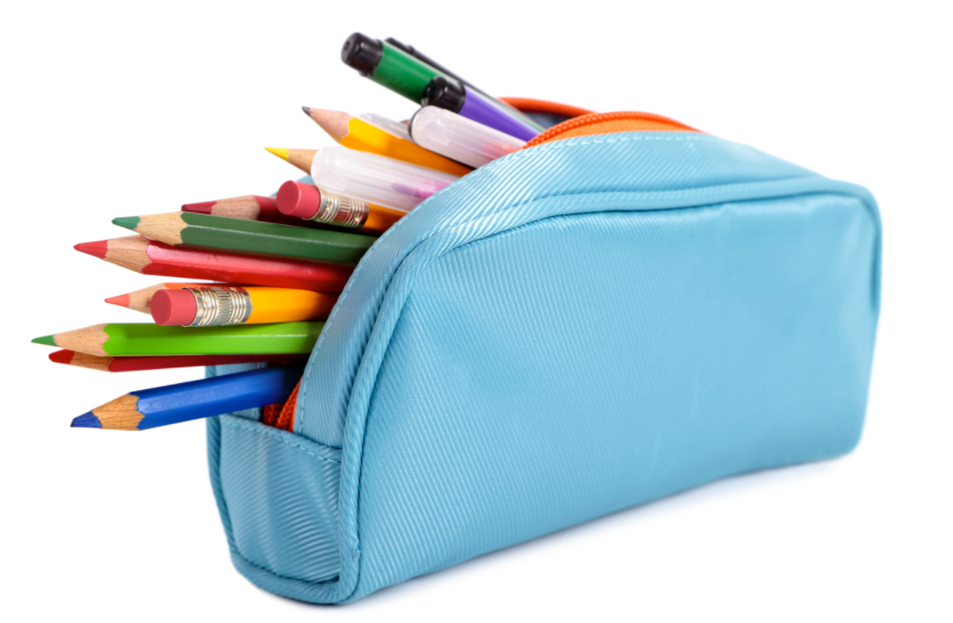
Expectations
As all resources will be provided by the school, we kindly ask that children to not bring pencil cases or stationery into school.

Slide 11
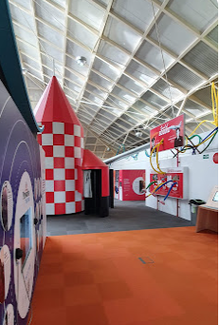
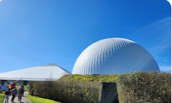
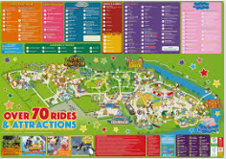


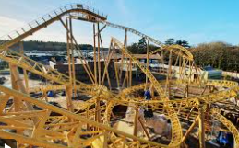
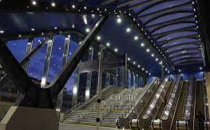
Winchester Science Museum and Planetarium
Trips and outings in Year 5
Paulton’s Park
Reading Train Station

Slide 12
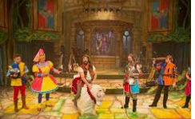


Winter Play.
Each year we are very lucky to be given the chance to showcase the many talents of Year 5 through dancing, singing and acting through a play in December. The children thoroughly enjoy coming together to perform for the schools and their families. Children can audition for leading roles/ smaller parts or even lighting and staging. Last year’s pantomime was excellent!
Every year we participate in Sports Week and Arts Week, which as you know, are fantastic weeks for the children to enjoy and showcase their many talents.

Slide 13

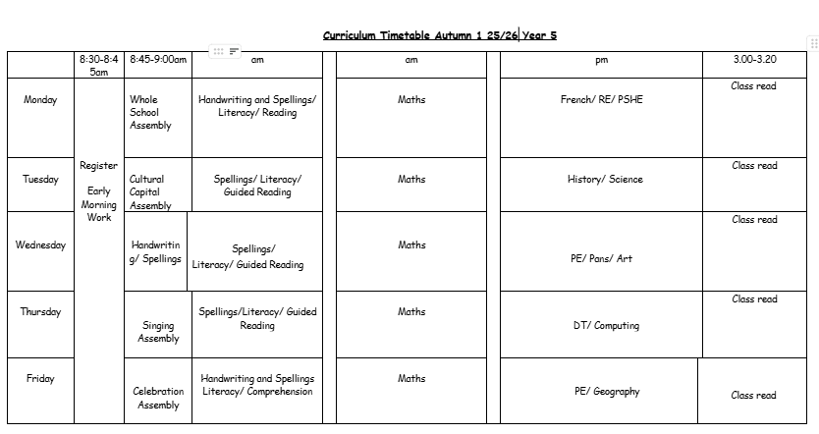
Timetable-Writing Gp- Miss Bedding

Slide 14
Please do come to us if you have any questions or concerns at all.
We do ask that you try not to catch us in the morning, as it is obviously very busy (If it is urgent, we will of course make the time). We will be happy to make an appointment with you after school, or you can email the office, who will always forward it on to us. We are here to support you and our main priority is that your child is happy at school.

Slide 15
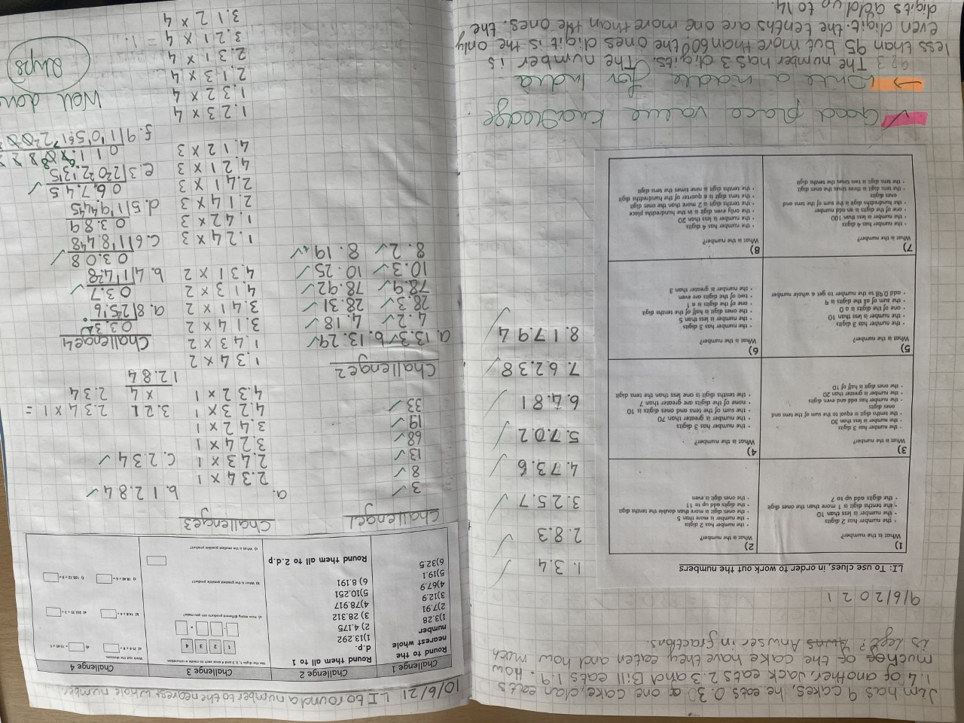
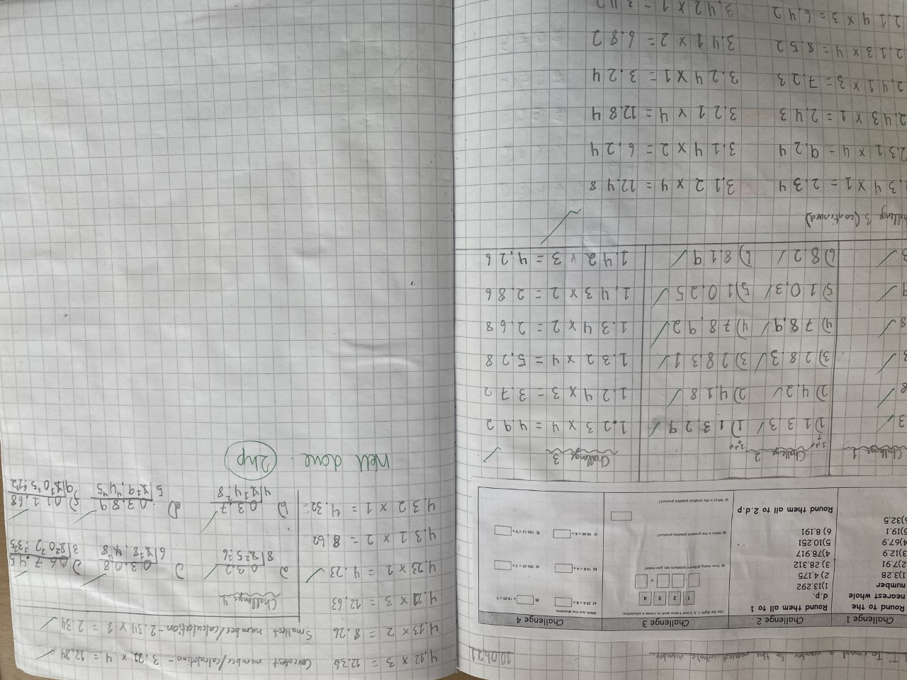
Examples of children’s work

Slide 16
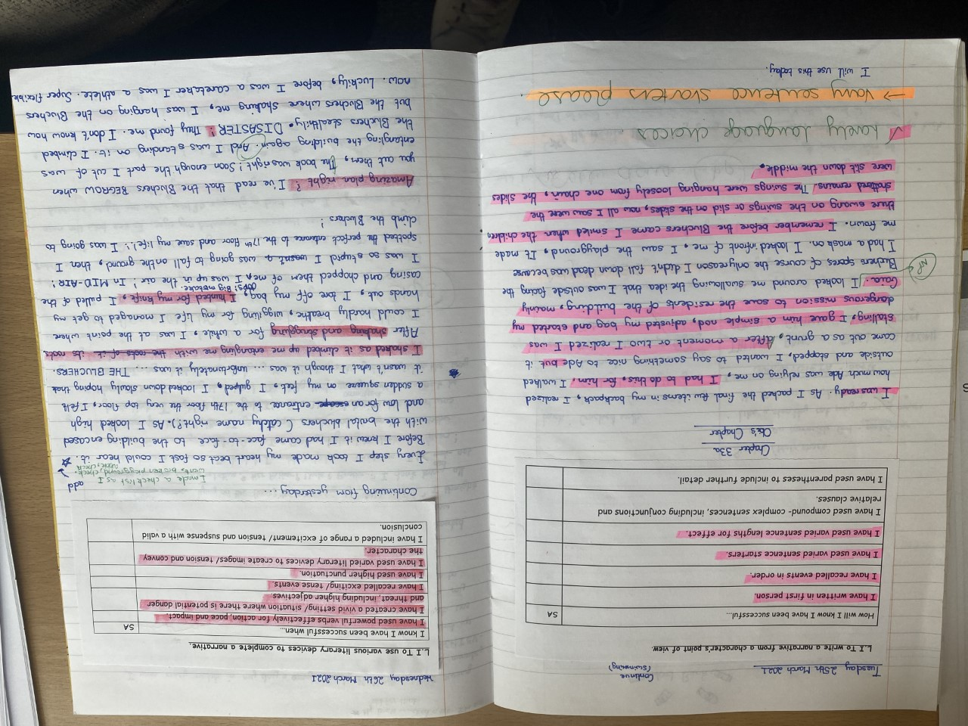
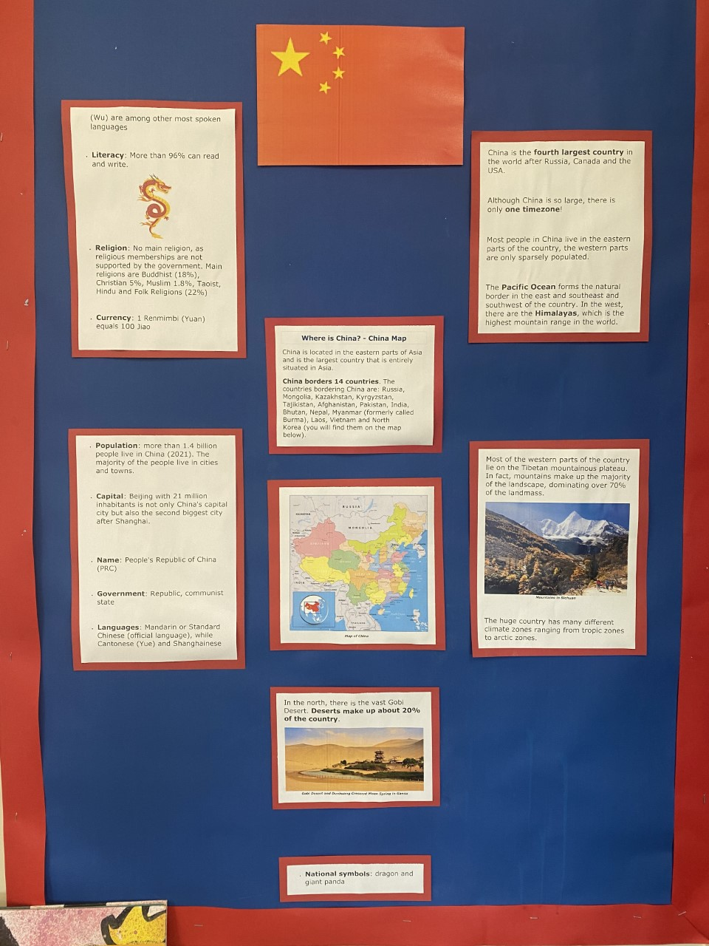

Slide 17
Any questions?

