Slide 1
Welcome to Year 2

Slide 2
The Year 2 team
Miss Wood and Mrs Woodward
Miss Tominey and Mrs Booker
Miss Drew, Mrs Jones and Mrs Ince
Miss Gawman will also be supporting across Year 1 and Year 2

Slide 3
The Year 2 Day
8.30 – Doors open – hang bags on pegs, come into the classroom for a morning activity
8.40 - Register
8.45 - Assembly
9.15– Phonics/Spelling
9.45 Maths/ Literacy
10.45 – Playtime
11.00 – Maths/ Literacy
12.00 – Lunch
1-00 – In from lunch and register
1.10 – Afternoon lessons
3.05 – Home time

Slide 4
Classrooms
As you may or may not be aware the Year 2 classrooms will be moving to the current Year 1 classrooms.
All children will come in through the doors by the terrapins.
Miss Wood’s (Mrs Aram current room) class will be dismissed from the terrapin doors that open out onto the playground.
Miss Drew’s (Mrs Dinnick’s current room) class will be dismissed from the terrapin doors on the opposite side to Miss Wood.
Miss Tominey’s (Miss Wood’s current classroom) class will be dismissed from her classroom door onto the playground.

Slide 5
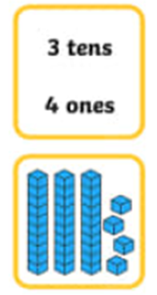

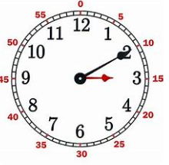
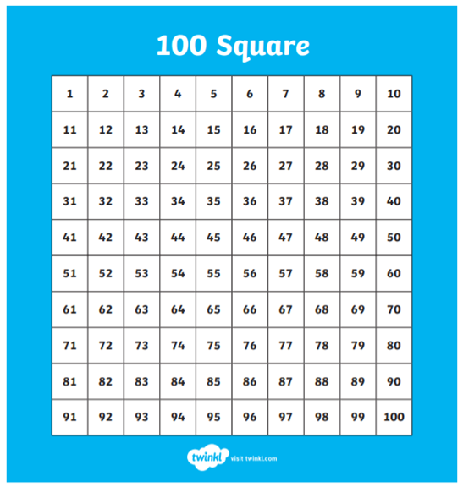




Topics
Maths
Number and place value
Addition and subtraction
Multiplication and division
Fractions
Measurement
Geometry (Shape)
Literacy
A selection of fiction units
A range of non-fiction units
Phonics/Spellings
Handwriting
SPaG (Spelling and Grammar)

Slide 6
Topics
History
The Tudors
The Gunpowder Plot
The Stuarts
The Victorians
Titanic
Local study of Reading Abbey
Other Subjects
ICT – Pictograms, Algorithms, Programming, Media
ART & D/T – Colour, Collage, Sculptures, Cityscapes, Wacky Races, Food Technology
PSHE - Celebrating differences, Dreams and Goals, Relationships.
Forest School will still be happening :)
Science
Materials
Living things and their habitats
Food chains
Lifecycles
Healthy Living
Plants
Geography
Kenya
Thailand
The United Kingdom

Slide 7
What happens this year:
Year 2 SATs
Phonics resit
Multiplication check for 2s, 5s and 10s

Slide 8
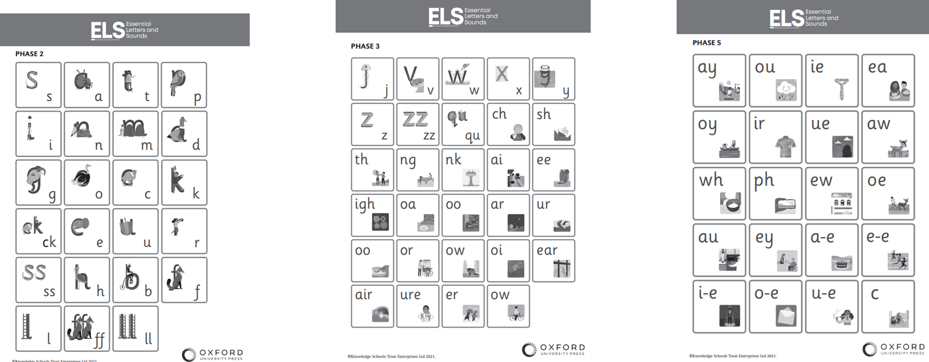
Supporting reading and writing through phonics

Slide 9
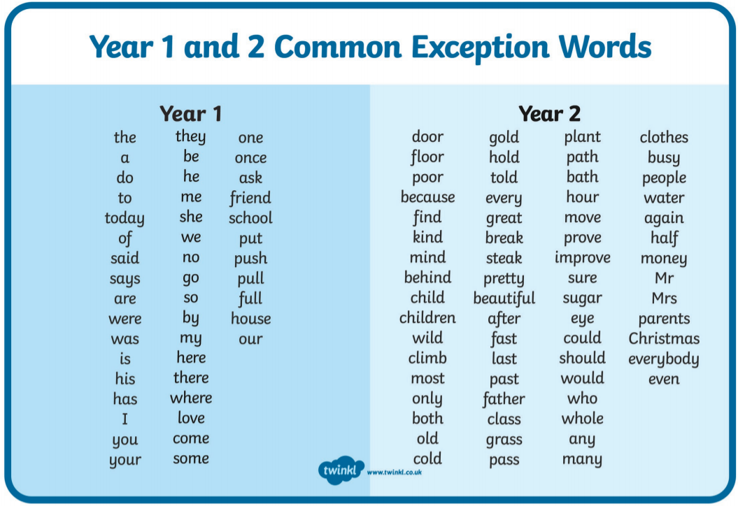
Common Exception Words
Notes:
These will be sent home after your final transition visit so you can begin working on them over the holidays if you wish. CHildren should be able to read AND spell these words.
They are called common exception words because they do not follow a phonetic rule - children should learn to read them and write them by sight NOT by sounding them out.

Slide 10
Reading
Reading is still a huge focus going into Year 2; it unlocks your child’s potential in all other areas of the curriculum!
Please read with your child daily! Every time you read with your child, please record it in their orange home-link books.
Children’s reading books will be changed weekly.
We encourage children to read each of their books 4 times.
  The first to decode
  The second to support with fluency
  The third to help with expression
  The fourth to support with understanding and comprehension
Notes:
These are things that are in the home school agreement that you sign at the beginning of each academic year.

Slide 11

Reading
On the tables, you will see some printed lists.
These are recommended books for children aged 6 -7 years old.
Please take one of these. They are fantastic books to share with your children as they progress through Year 2.
Notes:
These are things that are in the home school agreement that you sign at the beginning of each academic year.

Slide 12
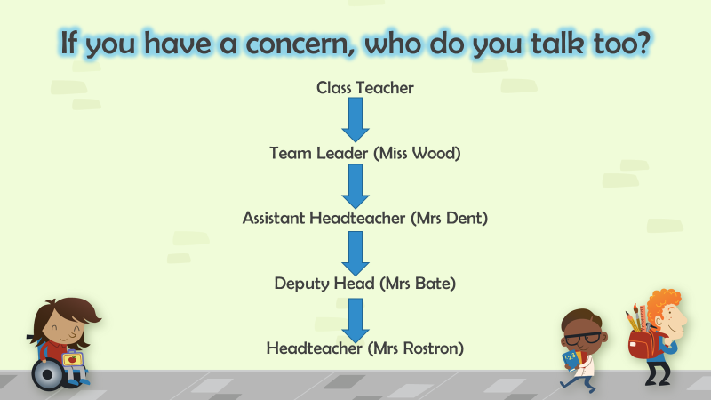
If you have a concern …

