Slide 1
Welcome to Year 1

Slide 2
The Year 1 team
1SA – Mrs Aram, Mrs S, and Ms Cowley
1CK – Ms Kurucz and Mrs Smith
Miss Gawman will also be supporting across Year 1 and Year 2

Slide 3
The Year 1 Day
8.30 – Doors open – hang bags on pegs, come into the classroom for a morning activity
8.40 - Register
8.45 - Assembly
9.15– Phonics
9.45 Maths/ Literacy
10.45 – Playtime (a snack of fruit will be provided)
11.00 – Maths/ Literacy
12.00 – Lunch
1-00 – In from lunch and register
1.10 – Afternoon lessons
3.05 – Home time

Slide 4
Drop off and Collection
All Year 1 children will come into school through the double doors in the Library.
Mrs Smith will be on the door. If you need to let the teaching staff know anything, please speak to Mrs Smith on the door as teacher will be in the classrooms settling children in for the day. If you need a meeting with the class teacher, please let Mrs Smith know and the teacher will ring you to arrange a mutually convenient time.
We ask that parents do not come into school in the mornings to help us get started with our learning as soon as possible.
At the end of the day (3.05pm) 1SA will be dismissed from their red classroom door. 1CK will be dismissed through the library doors that they enter through each morning.
On the first day of term, at 8.30, the teacher will come out of the library and line the children up to support them coming in ☺. After that, we will be using the library doors for children to come in more independently.

Slide 5
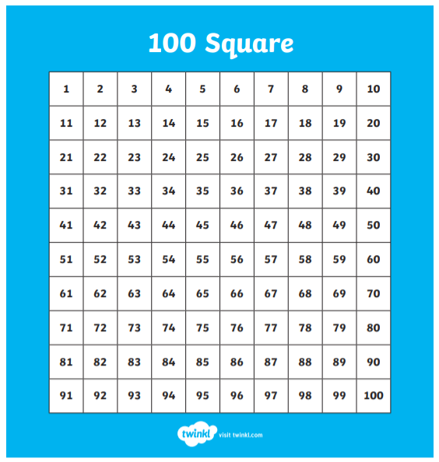



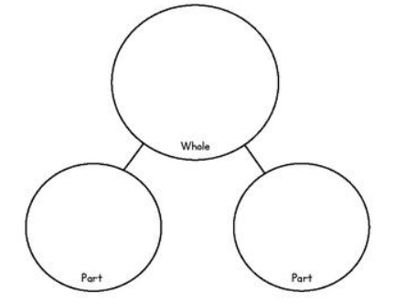

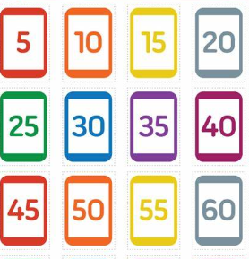

Maths
Number and place value
Addition and subtraction
Multiplication and division
Fractions
Measurement
Geometry (Shape)
Literacy
A selection of fiction units
A range of non-fiction units
Phonics
Handwriting
SPaG (Spelling and Grammar)

Slide 6
Topics Over the Year
History
Explorers
The Great Fire of London
Castle
Changes in living memory
Travel and Transport
Geography
The UK
Madagascar (Hot climate)
Canada or Antarctic (cold climate)
Science
Seasonal changes
Materials
Plants
Animals (including humans)
Habitats and environments
ICT – Chromebooks, Ipads, Beebots
ART & D/T – Using different media, Food technology, printing, free-standing structures.
PSHE - Celebrating differences, Dreams and Goals, Relationships.
Forest School!

Slide 7
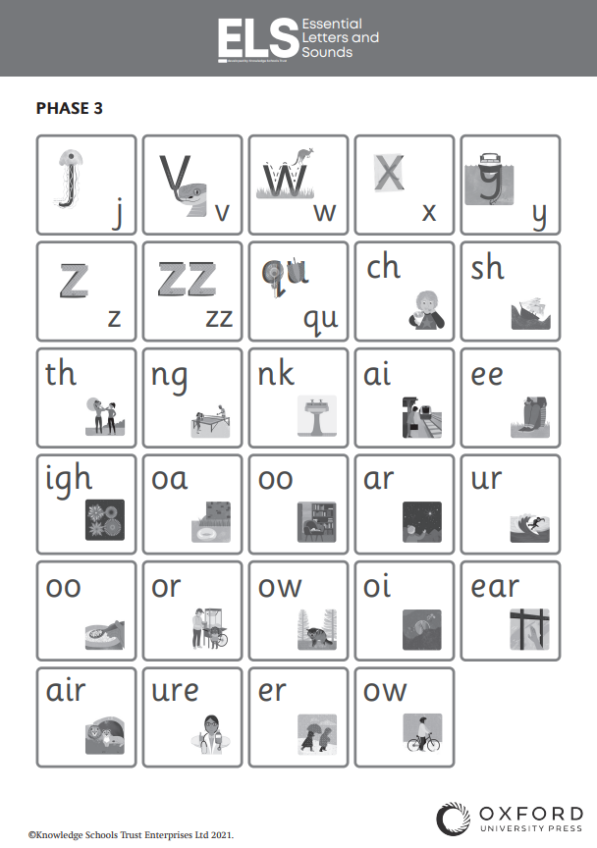
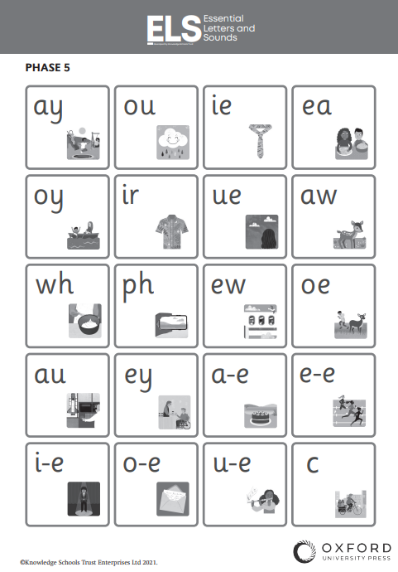
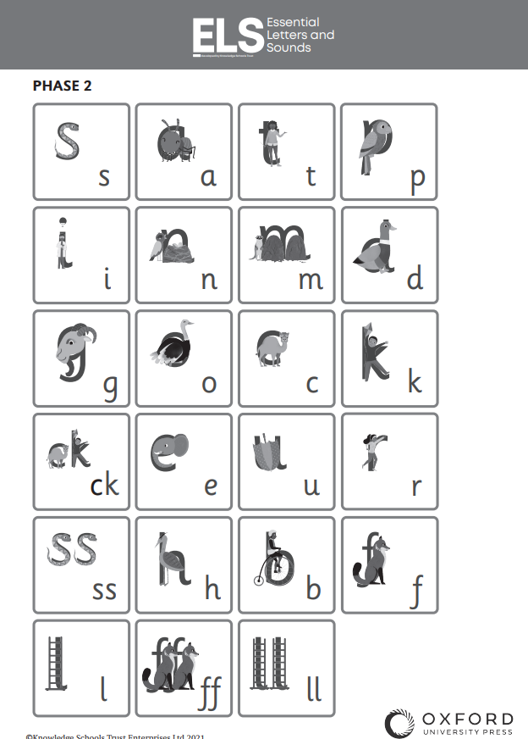
Supporting reading and writing through phonics

Slide 8
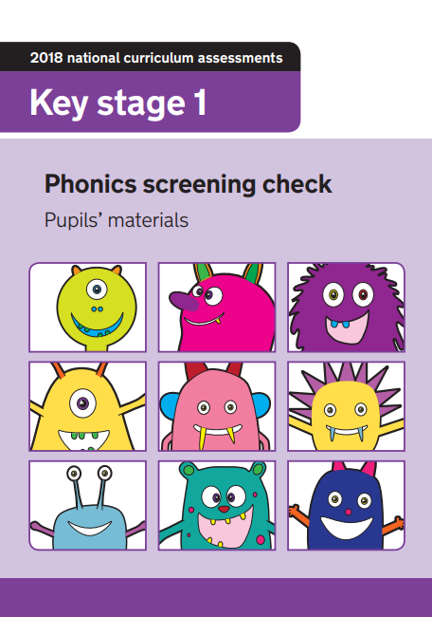
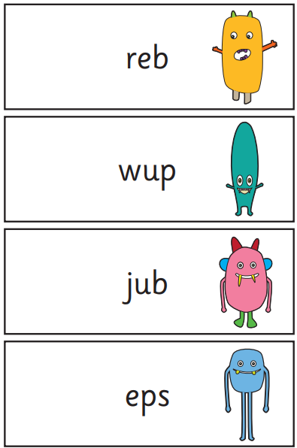
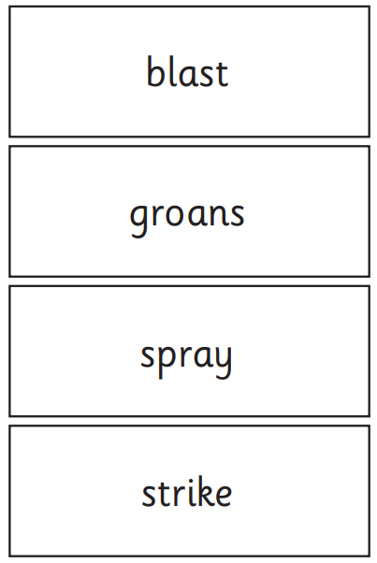
Year 1 Screening Check

Slide 9
Preparing for Year 1
During your child’s time in Year 1 we will be focusing a lot on building up their independence and organisational skills.
  Please encourage your child to dress themselves – buttons and zips!
Read, read, read! ☺
Practice reading and writing the Year 1 Common exception words (lists are on the tables)
Use Phonics Play (www.phonicsplay.com) lots of the games are free and will really help them when accessing Year 1 phonics.
Counting forwards and backwards within 20.

Slide 10
Importance of Reading!
Reading is one of the biggest element of Year 1 teaching; it unlocks your child’s potential in all other areas of the curriculum!
Please read with your child daily ☺
Every time you read with your child, please record it in their orange home-link books.
Children’s reading books will be changed weekly. They will have 1 phonics book, 2 shared book and 1 library book.
We encourage children to read each of their books 4 times.
          The first to decode
          The second to support with fluency
          The third to help with expression
          The fourth to support with understanding and comprehension
          On the tables you will find a recommended reading list for children within Year 1 as well as some examples of books the children should be able to access by the end of the year.

Slide 11

Importance of Reading!
On the tables, you will see some printed lists.
These are recommended books for children aged 5-6 years old.
Please take one of these. They are fantastic books to share with your children as they progress through Year 1.

Slide 12
Things to remember …
Home work is introduced during Year 1 – the expectations of this will be communicated in September.
Children’s books will be changed weekly.
Children will need a painting apron for art and DT. We are happy to keep these in the children’s trays. Please make sure that they are named.
Please ensure items of uniform, PE kit, water bottles and lunchboxes etc are named.
Children will not need pencil cases, anything needed for learning will be provided or a message will be sent out via Weduc.

Slide 13
If you have a concern, who do you talk too?
Class Teacher
Team Leader (Miss Wood)
Assistant Headteacher (Mrs Dent)
Deputy Head (Mrs Bate)
Headteacher (Mrs Rostron)

Slide 14
If you are worried …
A TA or teacher will be on the door every morning
A teacher will see your children out every afternoon
You are welcome to arrange a mutually convenient appointment at another time.

Slide 15
Thank You for listening
Any Questions?

