Slide 1

Welcome to Year 4!

Slide 2
Teachers
Teaching Staff: Ms. Lawless and Miss Munro
Teaching Assistants: Ms. Arthur, Miss Kilmartin and Mrs Warwick
Specialist Teaching: Art, Music, French and P.E

Slide 3



Expectations
We would really appreciate your support, by:
Ensuring your child arrives to school punctually.
Listening to your child read everyday.
Supporting your child with the completion of their homework.

Slide 4
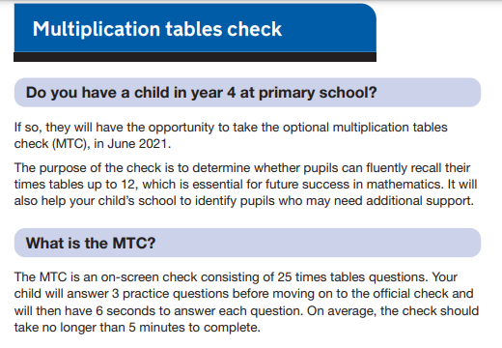
What does Year 4 look like?
https://www.gov.uk/government/collections/multiplication-tables-check#information-for-parents
Multiplication tables up to 12 x 12 and corresponding division facts is really important in Year 4.
The government have now made it compulsory.
Planning in Maths will incorporate teaching time for the multiplication tables.
TT Rockstars is a fantastic resource.
Timestable club.

Slide 5
What does Year 4 look like?
Learning will be based on needs.
We will be running boosters for children who need to make accelerated progress.
We have specialist teaching for French, Music, P.E, and Art.
School trip (dates, times, place TBC).
Rock Project.
Extra curricular activities.
Stationery.
New timings: 8:30-3:05 (Lunch finishes at 12:50).

Slide 6
Term Beginnings
PSHE.
Time in classes.
Reading.

Slide 7
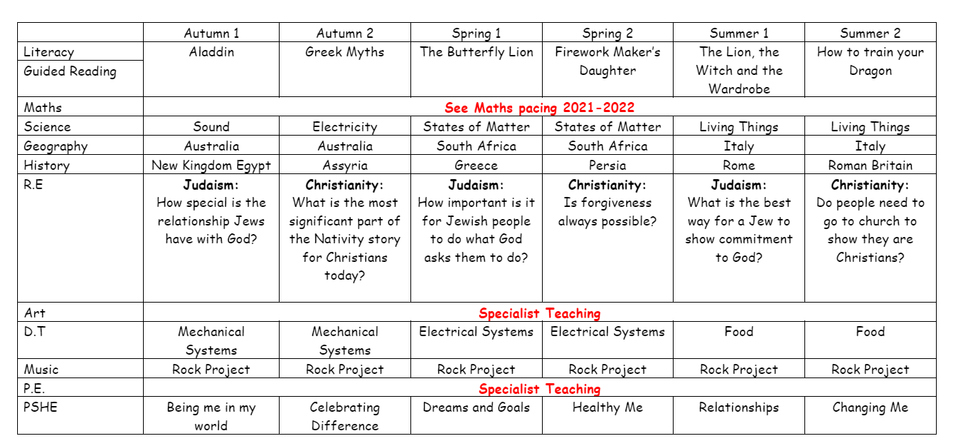
Curriculum Overview

