Slide 1
Welcome to Year 3

Slide 2
Meet the teachers
3ST - Mrs Togher and Mrs Malone,
3AB - Miss Bedding and Mrs Felix
3NC - Ms Chughtai and Mrs Buckle

Slide 3
Daily Timetable
8:30 - Registration
9:00 - Spelling / Phonics
9:30 - Literacy
10:30 - Break
10:45 - Maths
11:45 - Handwriting
12:00 - Lunch
12:50 - Registration
1:00 - Topic
2:00 - Topic
3:00 - Tidy up
3:05 - Home time

Slide 4



Literacy
The Stone Age Boy
Flat Stanley
Fantastic Mr Fox
Poetry
Year 3 spellings
Narratives and non-narratives
Sentence structures: expanded noun phrases, conjunctions, prepositions, adverbs
Punctuation, including speech

Slide 5

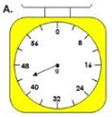

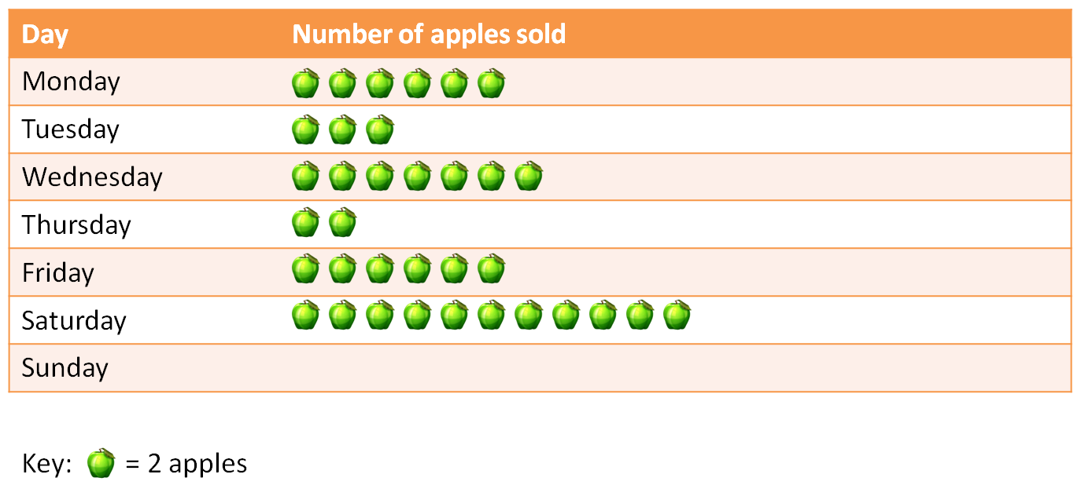
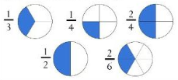
Maths
Place value - 3 digit numbers, numerals and words
Addition and subtraction - 3 digit numbers, mental and formal written methods
Multiplication and division - 3, 4 and 8 times tables, formal written methods.
Fractions, measure, geometry and statistics

Slide 6

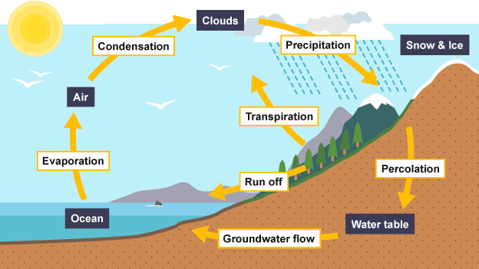

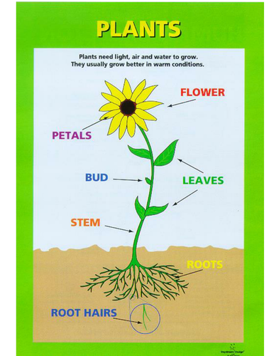
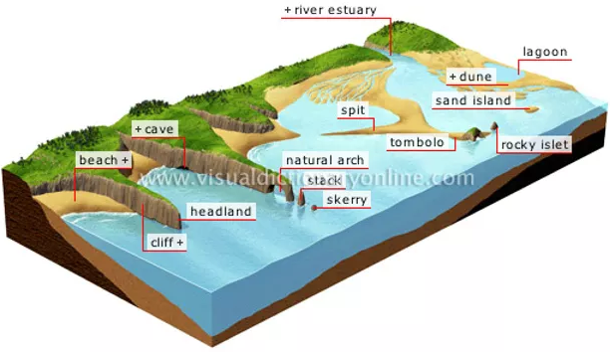
Foundation
Subjects
Science
Rocks
Forces and Magnets
Plants
Humans and other animals
Light and Shadow
Geography
Volcanoes, earthquakes and Mountains - USA
Rivers, the water cycle and farming - Egypt
Features of a coastline, natural resources - Ireland

Slide 7
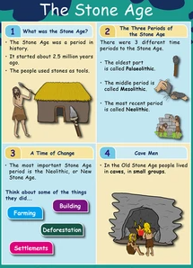


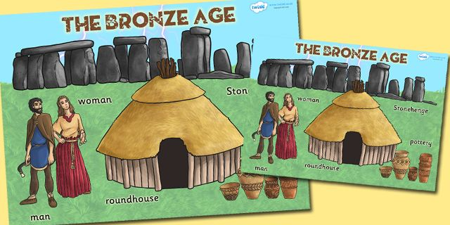
Foundation
Subjects
RE
Hinduism
Christianity
History
The Stone Age
Early Egypt
The Bronze Age
Shang Dynasty
Iron Age
Babylonia

Slide 8
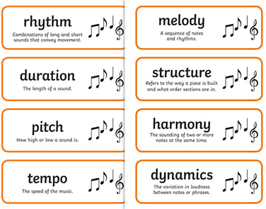

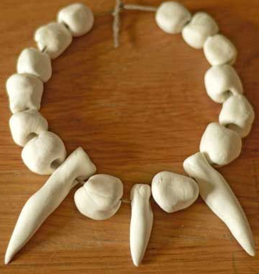
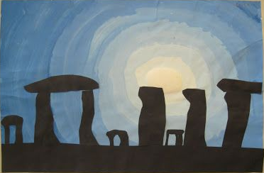



Foundation
Subjects
French
Music
Art
D & T
Computing
PSHE
PE

Slide 9
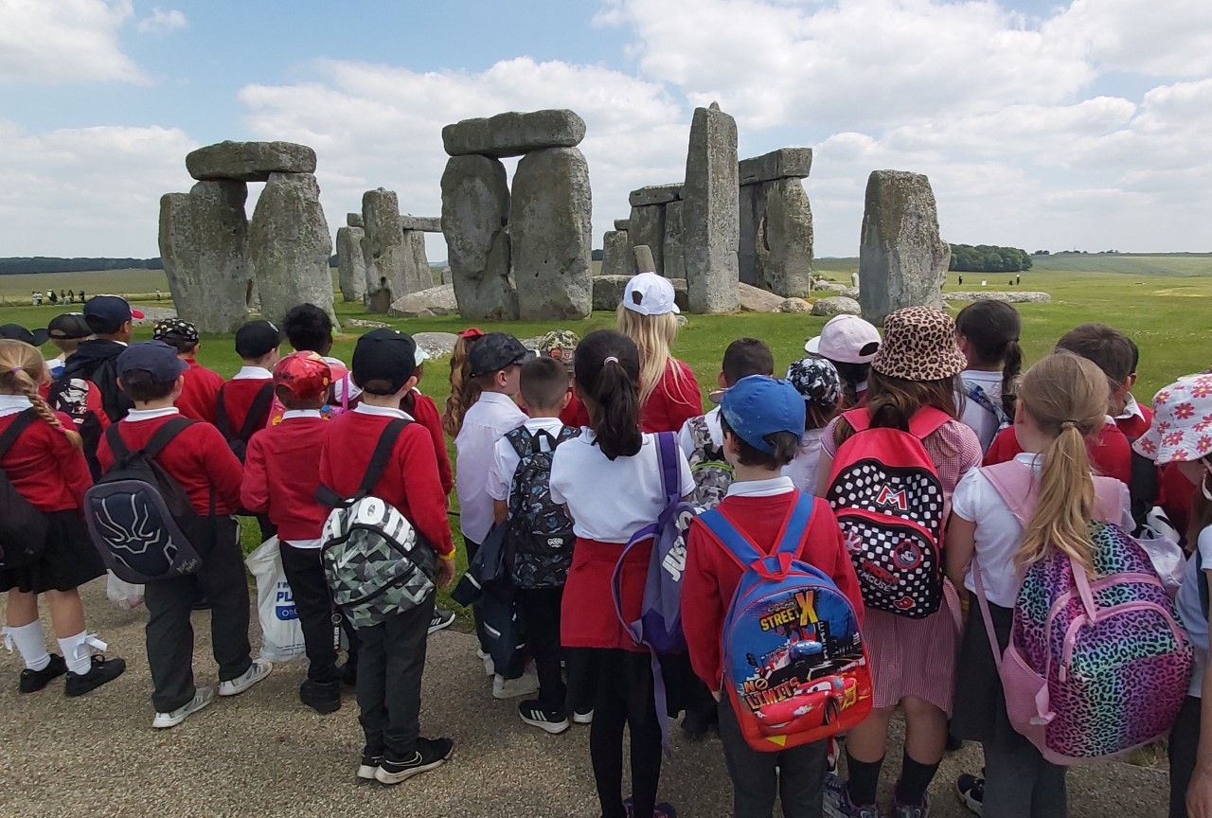
School Trips
We plan to make three trips during the year:
Stonehenge in the Autumn
Museum and theatre in the Spring
Farm visit in the Summer.

Slide 10
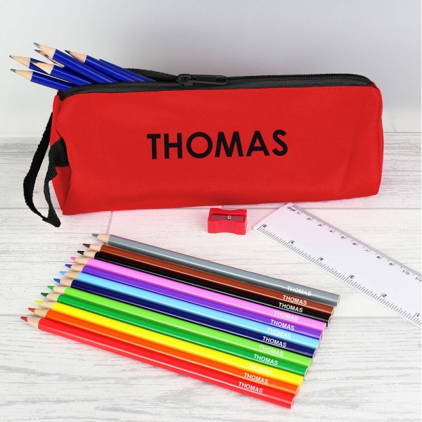
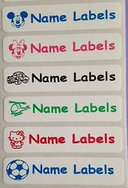
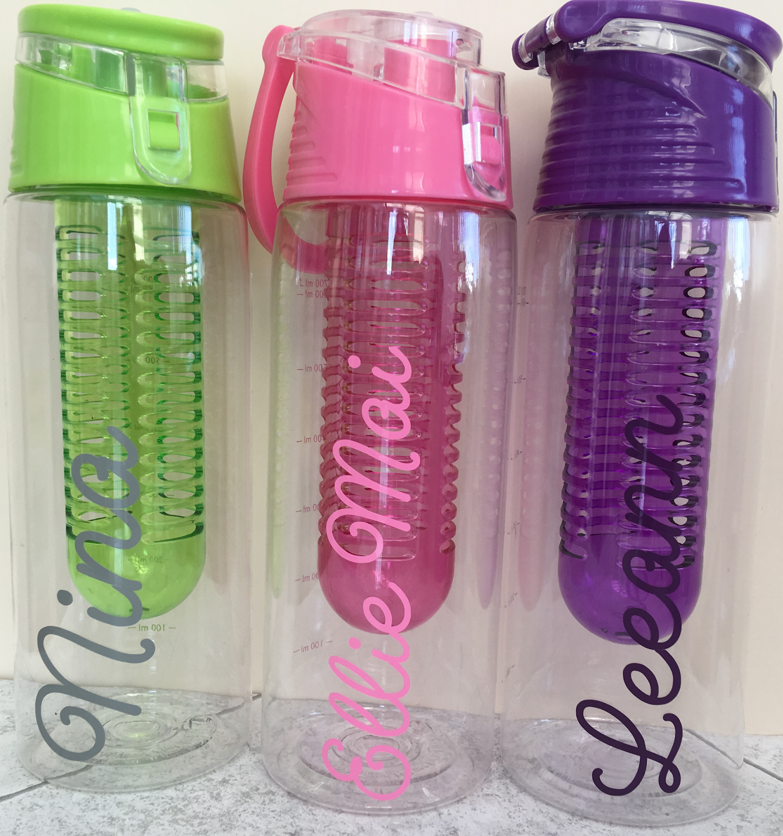
Things to remember
Name in all school uniform and PE kit
PE kits to be worn on PE days
Water bottle - named
Small pencil case: writing pencils, colouring pencils, rubber, pencil sharpener, ruler - other stationery will be supplied in school
Homework is set on Fridays and needs to be completed and returned by the Wednesday of the next week
Reading Records - these should be brought in every
day. Please read with your child every day and record
this in the reading record.

Slide 11

Any questions?

