Slide 1

Maths at Calcot Junior School

Slide 2
Aims of the maths curriculum:
-become fluent in the fundamentals of mathematics
-reason mathematically by following a line of enquiry, conjecturing relationships and generalisations, and developing an argument, justification or proof using mathematical language
-can solve problems by applying their mathematics to a variety of routine and non-routine problems with increasing sophistication, including breaking down problems into a series of simpler steps and persevering in seeking solutions

Slide 3
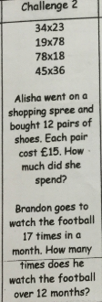
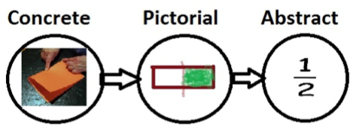
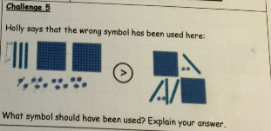
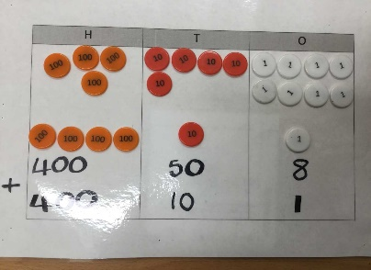
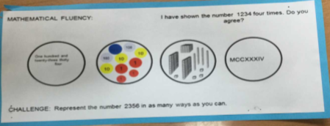
How does maths look at Calcot?

Slide 4
Fluency>Problem Solving>Reasoning
F | P.S | R
3+7= 9+1= 10=2+___ | Tom has 7 pens but his teacher said that he must find all 10. How many more does Tom need? | Miss Buck says ‘when I add 7 and 3, it doesn’t matter which way round I do it, I will always get the same answer.’ Is she correct? Explain

Slide 5
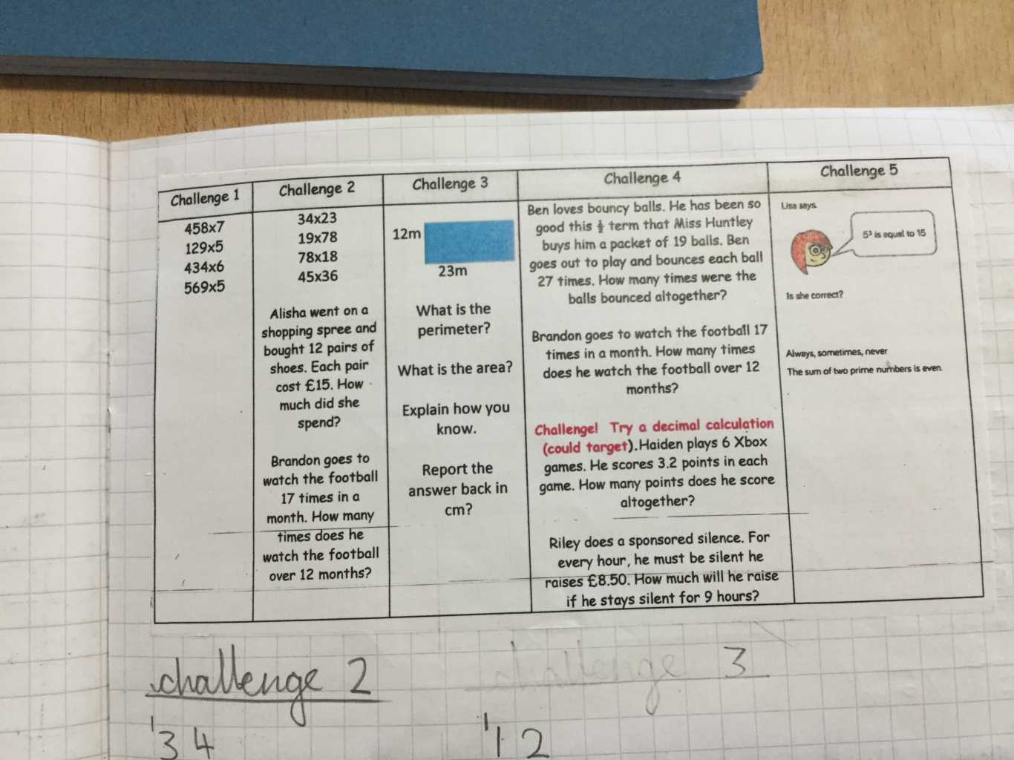
What you will see in books
Fluency>problem solving>reasoning

Slide 6
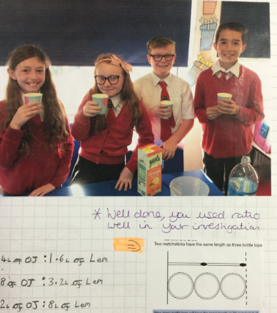
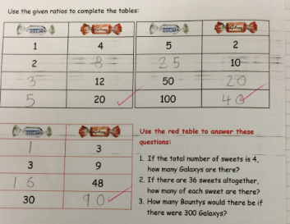
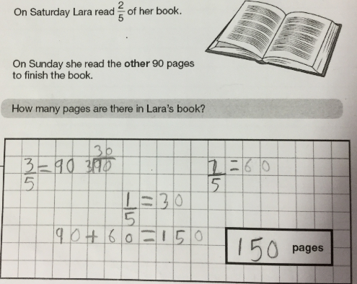


The real life context

Slide 7
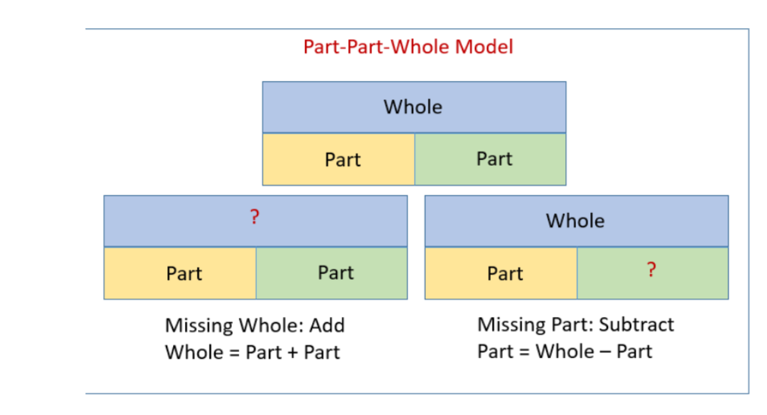

Slide 8
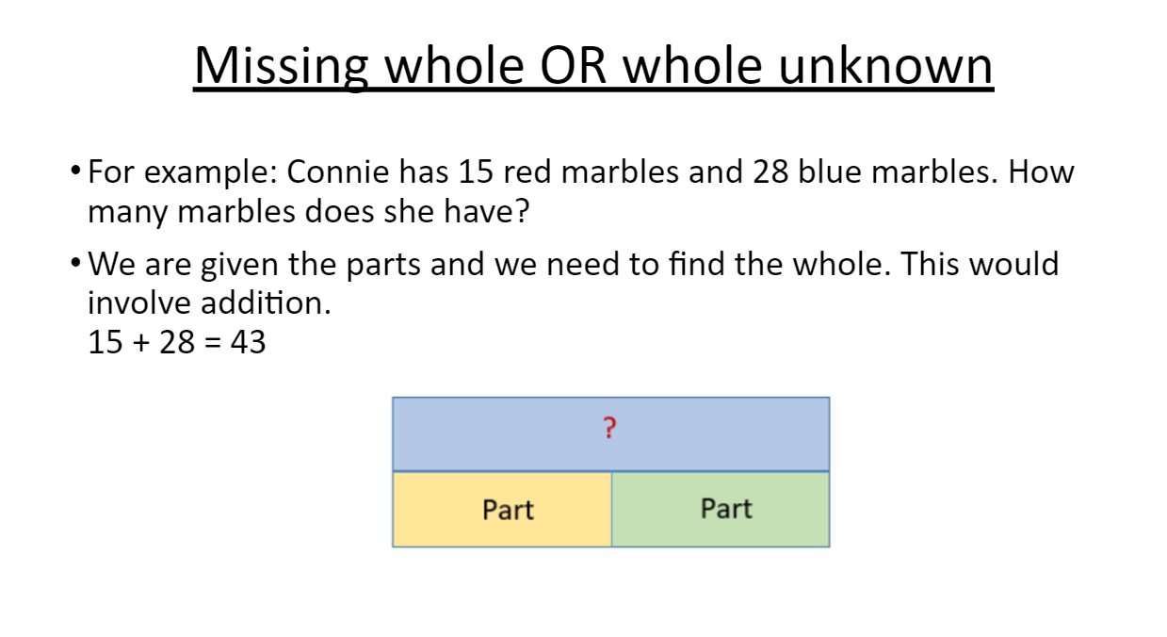

Slide 9
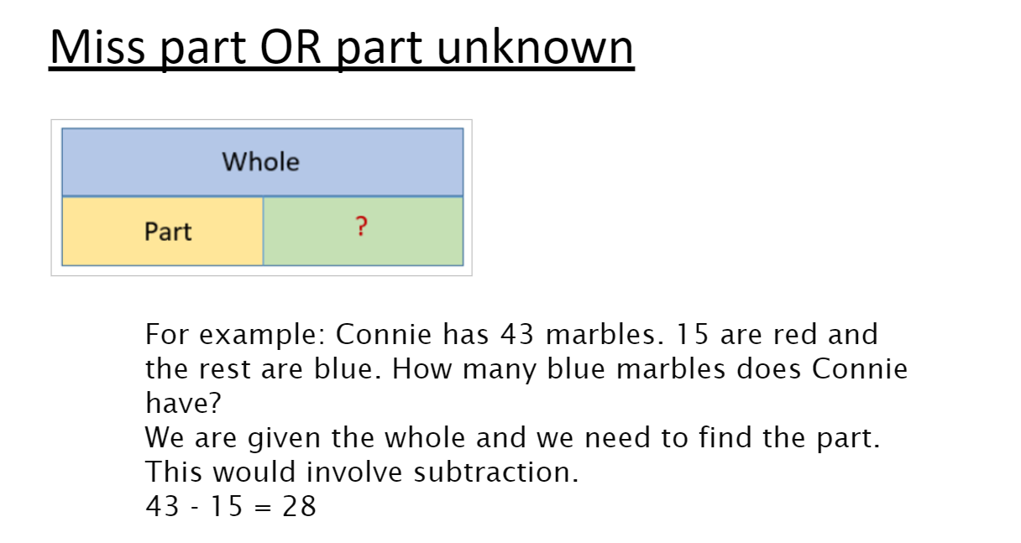

Slide 10
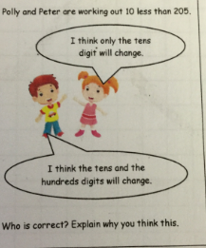
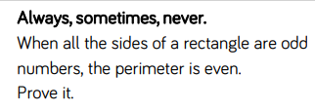
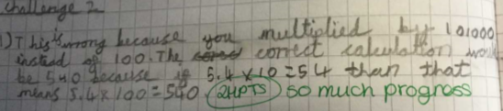
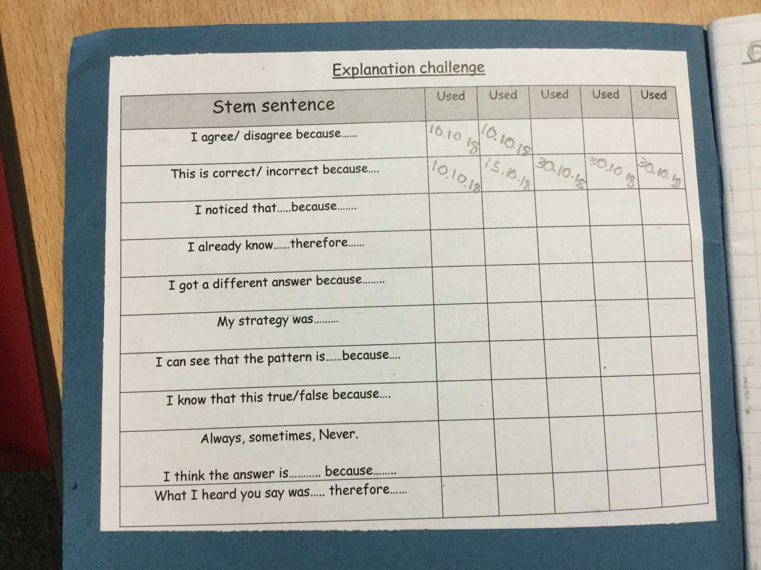
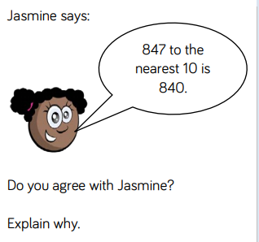
Reasoning

Slide 11
Questions to encourage problem solving and reasoning
Can you show me this in another way?
Prove that….?
How do you know that….?
Always/sometimes/never….?
True or false…?
The answer is ……., tell me why.
Which is the odd one out?

Slide 12
If I know…. then I know……
6X7=42

Slide 13
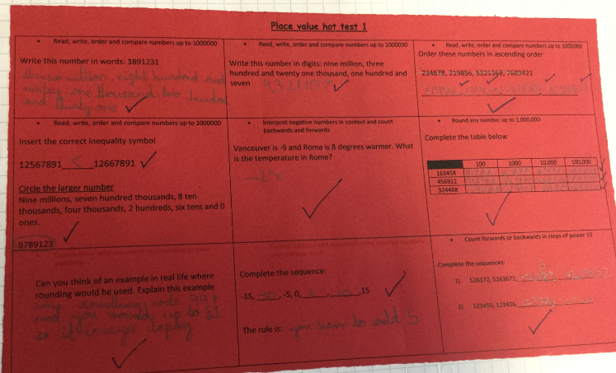
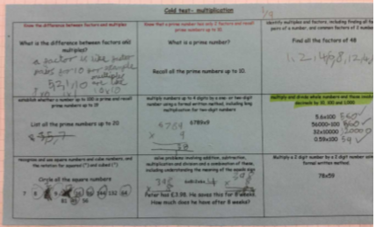
How do we assess and plan?
SATS
PUMA
LESSON TO LESSON

Slide 14
First time, this year
From the 2019 to 2020 academic year onwards, schools in England will be required to administer an online multiplication tables check (MTC) to year 4 pupils.
The national curriculum specifies that pupils should be taught to recall the multiplication tables up to and including 12x12 by the end of year 4.
The purpose of the MTC is to determine whether pupils can recall their times tables fluently, which is essential for future success in mathematics. It will help schools to identify pupils who have not yet mastered their times tables, so that additional support can be provided.
Counting
PACKS AVAILABLE
patterns
TTRS
connections

Slide 15
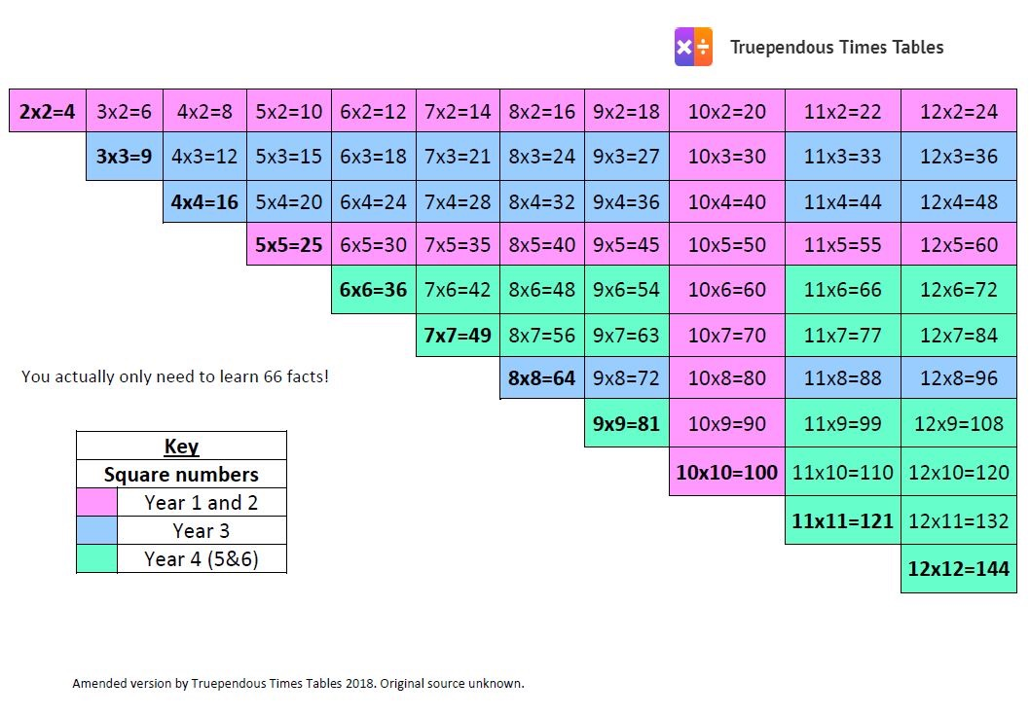

Slide 16
What do the children think of maths here?
'I can find maths tricky but when we use counters and equipment, it really helps me.'
'I like the 5-way challenge because you can choose your own learning and there i always something to do.'
'I am always really proud of myself when I do lots of challenges. I find explaining my maths hard though.'
'I love maths!'
'I used to be scared of maths but I am not anymore because I just try.'
' I like the 5-way challenge because I am never bored or have nothing to do. My teacher supports me to be the best I can be.'
'Maths is my favourite subject at school.'
' We have started doing Hot and Cold tests and I love them because I can see how well I am doing. I love improving my score. I went from 2/9 to 7/9 in multiplication

Slide 17
What is the impact of what we do?
2016 | 2017 | 2018
50.9% | 63% | 81.2%

